Slide 1
Connection Survey

Slide 2
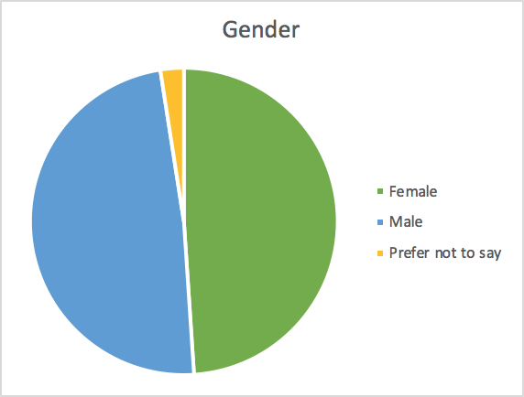
Gender

Slide 3
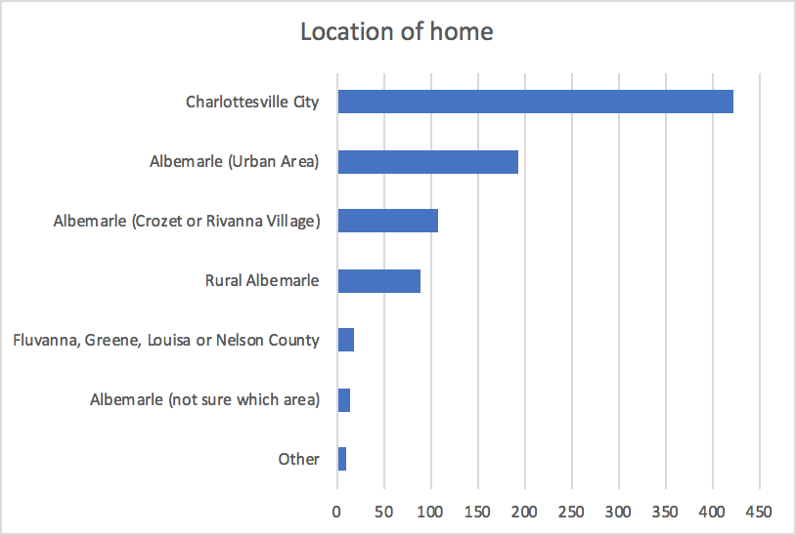
Location of home

Slide 4
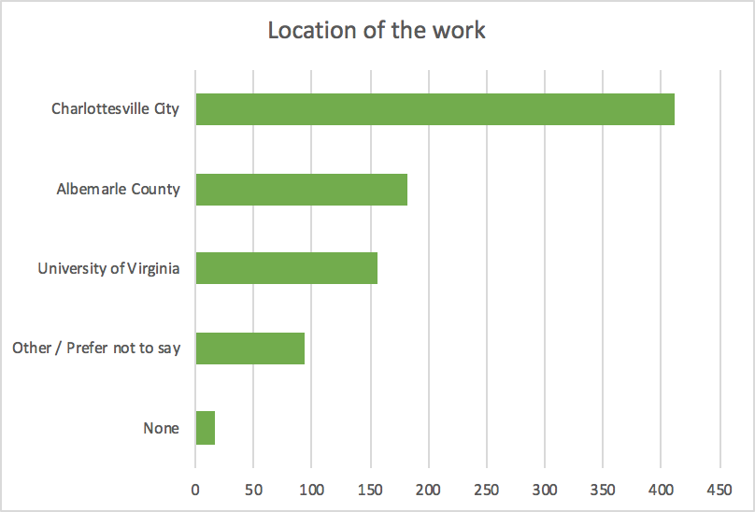
Working place

Slide 5
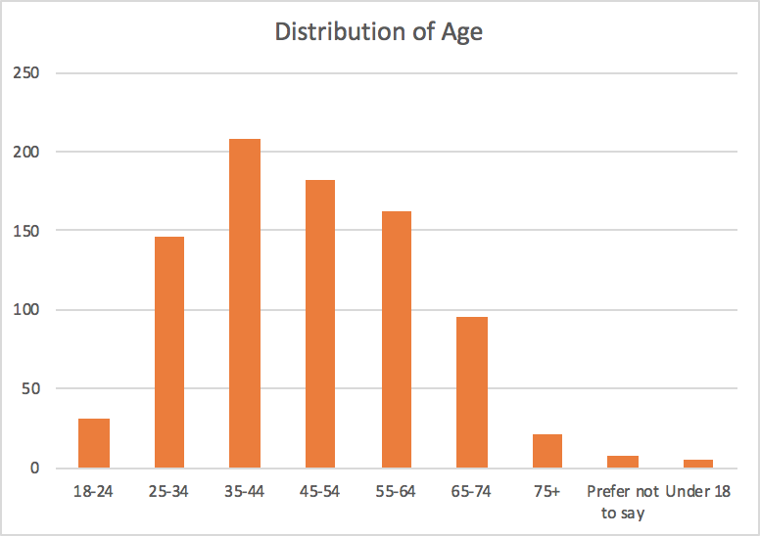
Age

Slide 6
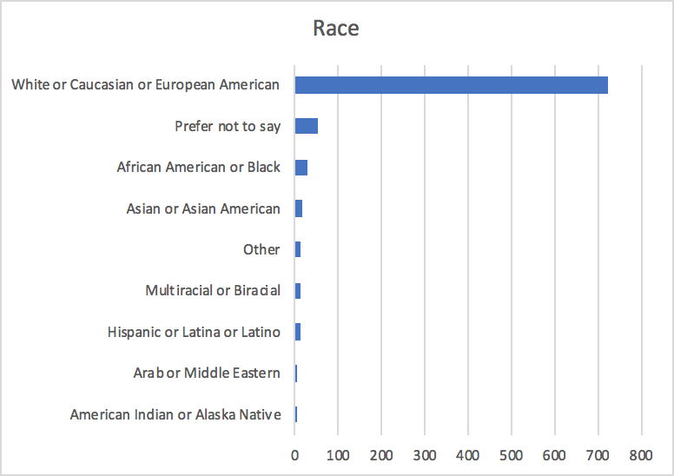
Race

Slide 7
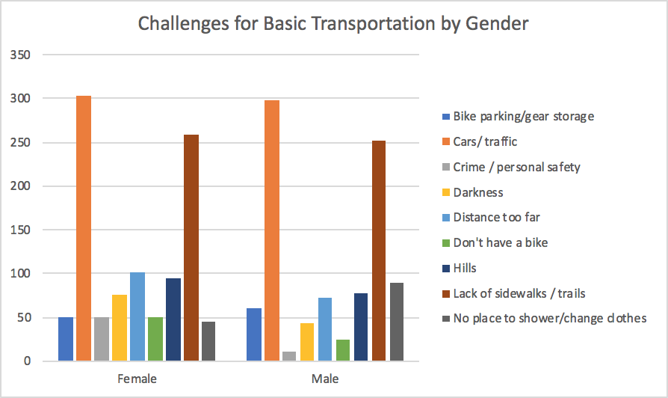
Challenges for basic transportation by gender

Slide 8
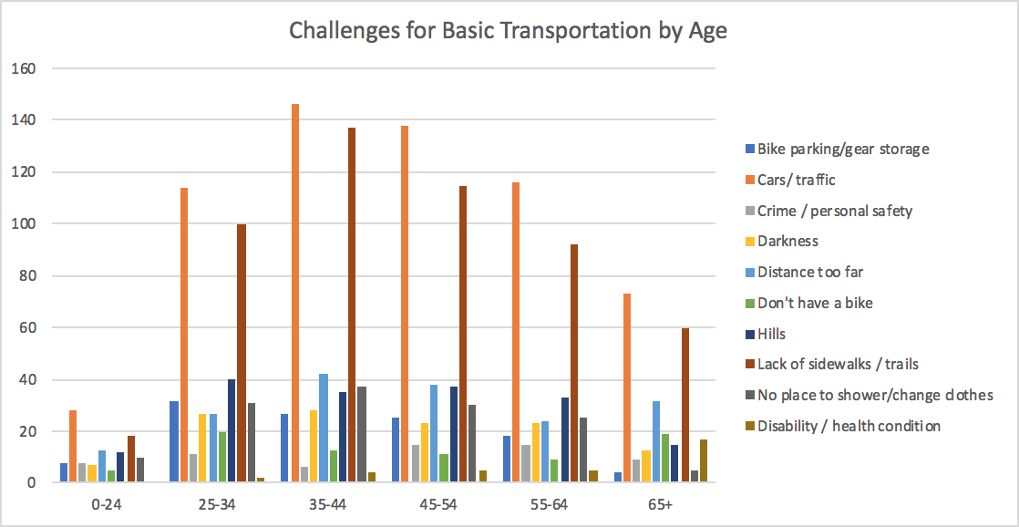
Challenges for basic transportation by age

Slide 9
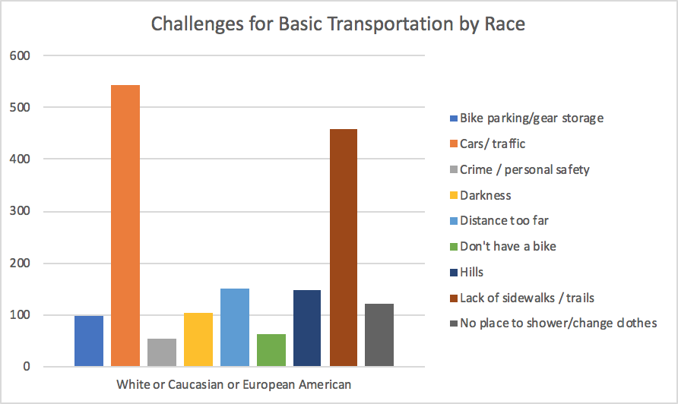
Challenges for basic transportation by race
* Since more than 90% of the reponses are filled by White or Caucasian or European American, it is hard to compare the challenges by race

Slide 10
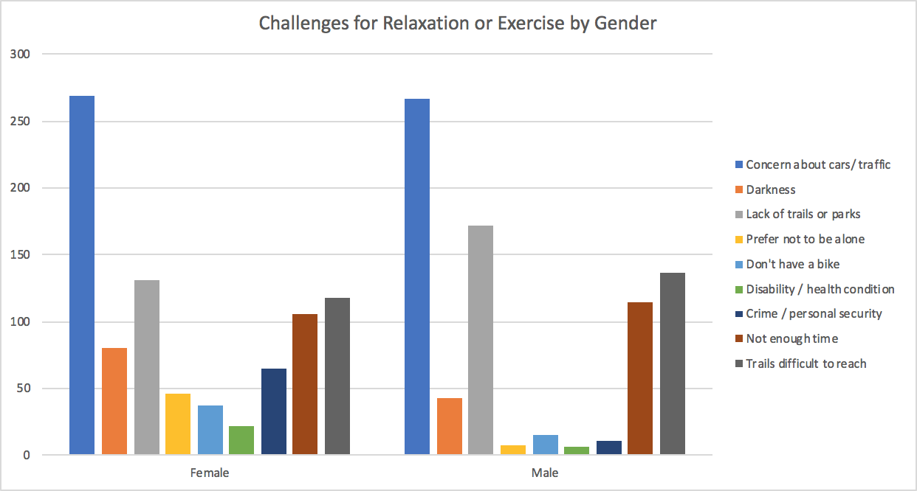
Challenges for relaxation by gender

Slide 11
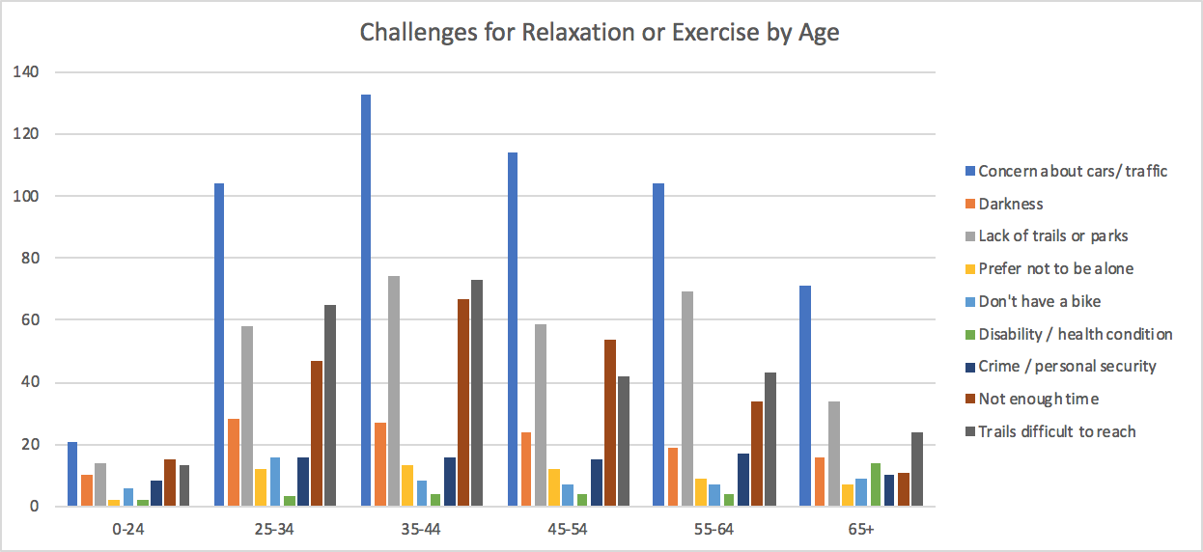
Challenges for relaxation by age

Slide 12
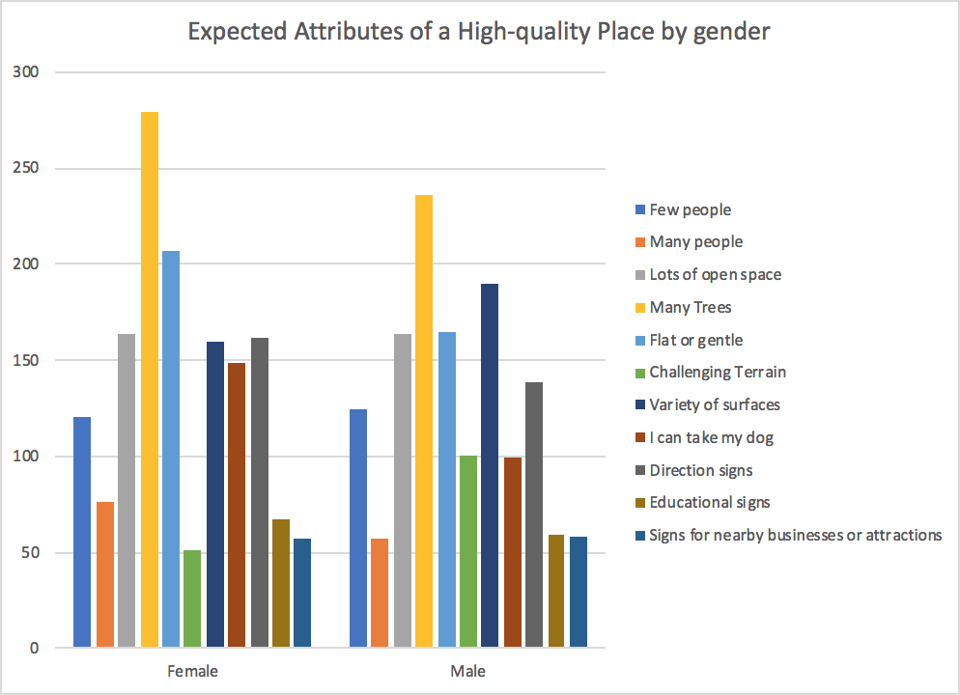
Expected attributes of a high-quality place by gender

Slide 13
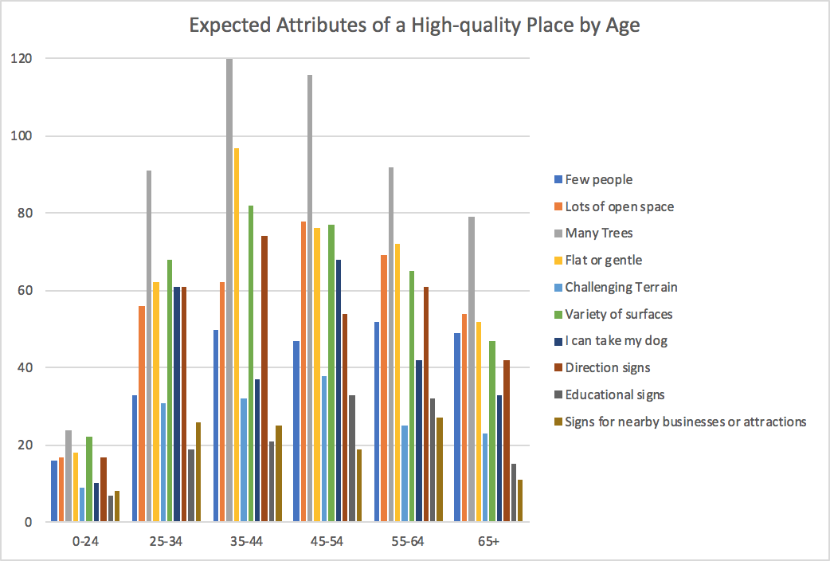
Expected attributes of a high-quality place by age

Slide 14
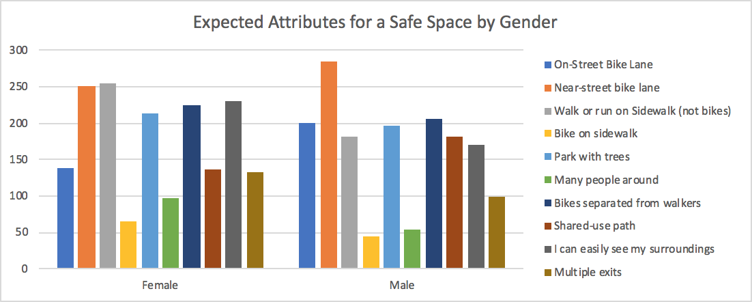
Expected attributes of a safe place by gender

Slide 15
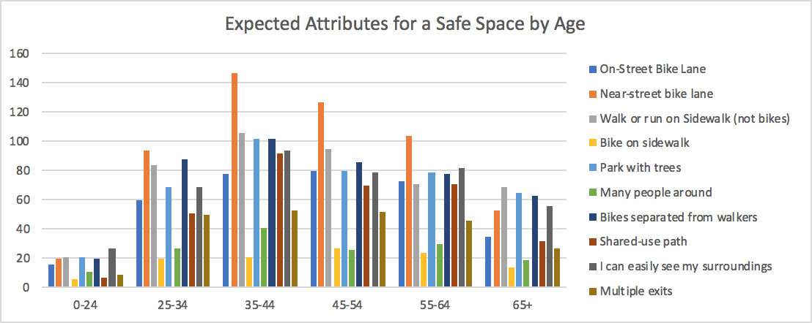
Expected attributes of a safe place by age

